Slide 1

DLYA DATA SCIENCE AND MACHINE LEARNING BOOTCAMP 3.0
GROUP 12
THE EARTH DISTRIBUTION OF METHANE EMISSION FROM YEAR (1990-2018) AND IT’S POSSIBLE EFFECT ON CLIMATE CHANGE AND HUMAN HEALTH USING MULTIPLE REGRESSION MODEL
AKANJI OLUWASEUN GABRIEL
ABDUL TEMITOPE JULIANAH
IBRAHIM AMUDA
ABDULWASIU B. POPOOLA
ESIRI CYNTHIA IDADOKIMA
ABIODUN IYIOLA
ITA ESTHER
CAPSTONE PROJECT
NOVEMBER 2022

Slide 2
TABLE OF CONTENTS
01
Introduction
Methodology
Code Implementation
Data Visualization
Modelling and Testing
Evaluation

Slide 3


INTRODUCTION
Methane a colorless, odorless gas with the chemical formula CH4 is a major contributor to global warming. According to energyindustyreview.com Methane is the main harbinger of ground-level ozone build-up in the lower atmosphere(troposphere) which is toxic to human health.
The study contains detailed quantitative and qualitative data analysis of continuous methane emissions in MTCO2e ( Metric tons of carbon dioxide) for 195 countries from 9 major sectors namely Agriculture, Energy, Waste, Fugitive Emission, Other Fuel Combustion, Land-Use Change and Forestry (LUCF), Total Including LUCF, and Total Excluding LUCF to determine it’s increasing effect on climate change and human health between the year 1990 to 2018.

Slide 4
Project Aims
01
02
03
04
Analyze the features contributing majorly to methane emission
Predict methane emmission using Multiple Regression Model
Quantifying the largest emmiters of methane in the world
Evaluation

Slide 5
METHODOLOGY
Modelling and Testing
Data Gathering and Collection
Data Cleaning and Transformation
Code Implementation
Data Visualization
Evaluation And Conclusion

Slide 6
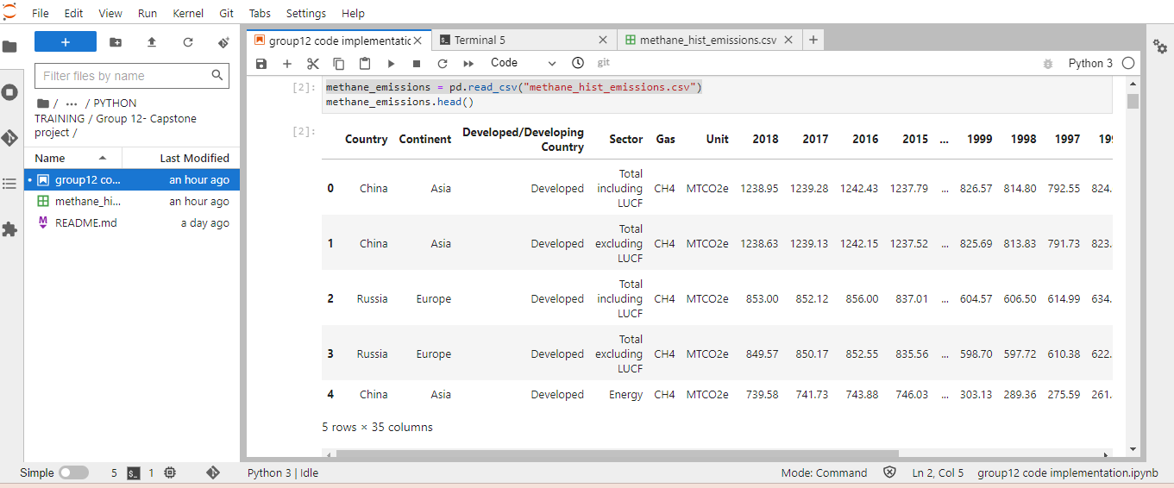
Data Cleaning
The data was cleaned and new column indicating, continent ,developing and developed countries was added.
02
03
Fig. 1

Slide 7
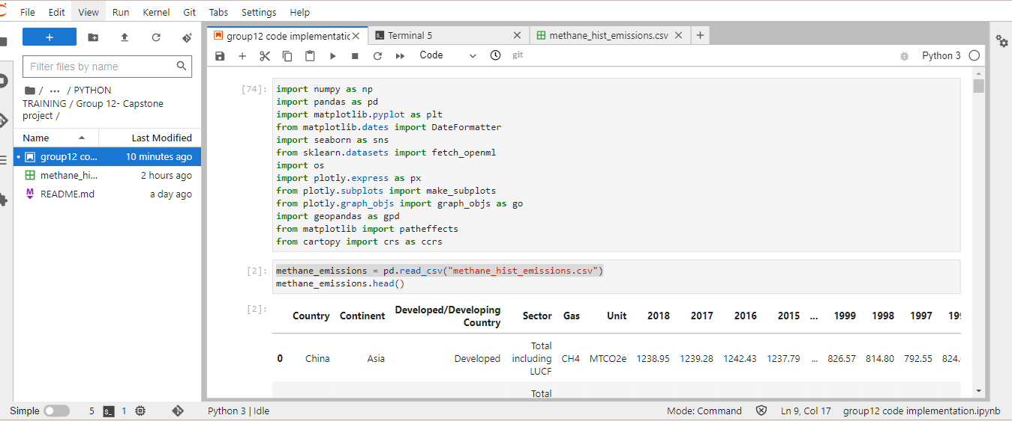
CODE IMPLEMENTATION
Coding Libraries Used
Numpy.
Pandas
Matplotlib
Sklearn
Fig. 2

Slide 8
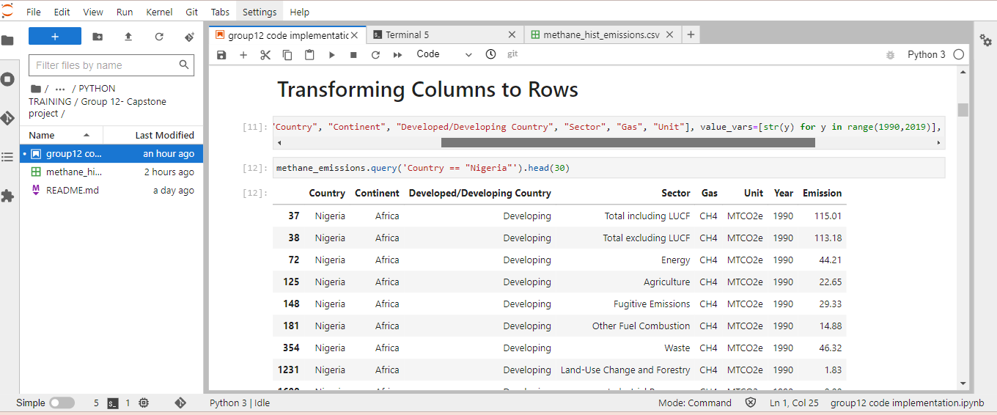
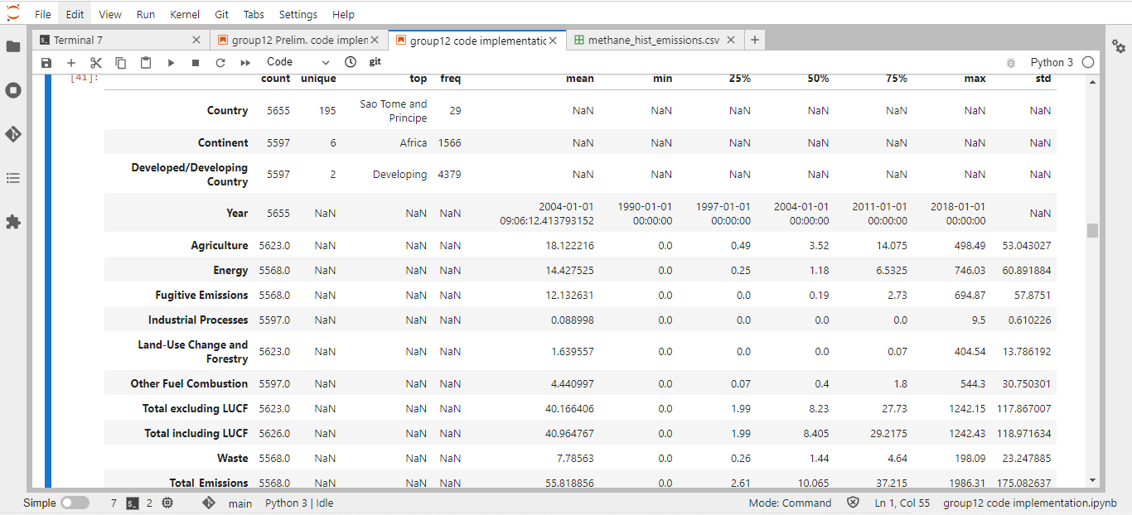
Education policy
CODE IMPLEMENTATION CONTD
Title text addition
Title text addition
The user can demonstrate on a projector or computer, or print the presentation and make it film
The user can demonstrate on a projector or computer, or print the presentation and make it film
Title text addition
Title text addition
The user can demonstrate on a projector or computer, or print the presentation and make it film
The user can demonstrate on a projector or computer, or print the presentation and make it film
Title text addition
Title text addition
Fig. 3b
The user can demonstrate on a projector or computer, or print the presentation and make it film
Fig. 3a
The user can demonstrate on a projector or computer, or print the presentation and make it film

Slide 9
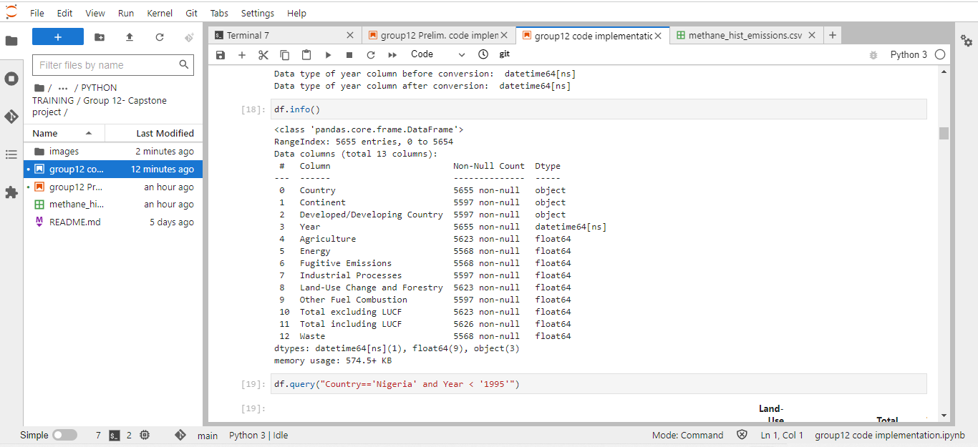
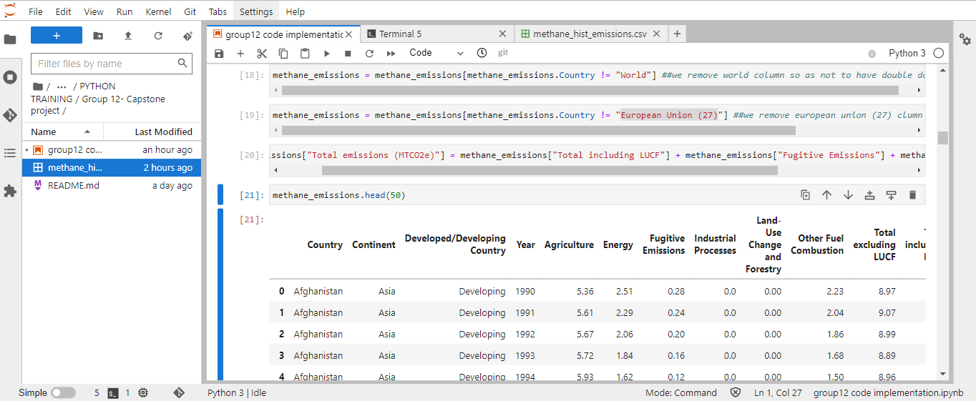
CODE IMPLEMENTATION CONTD
Fig. 4a
Fig. 4b

Slide 10
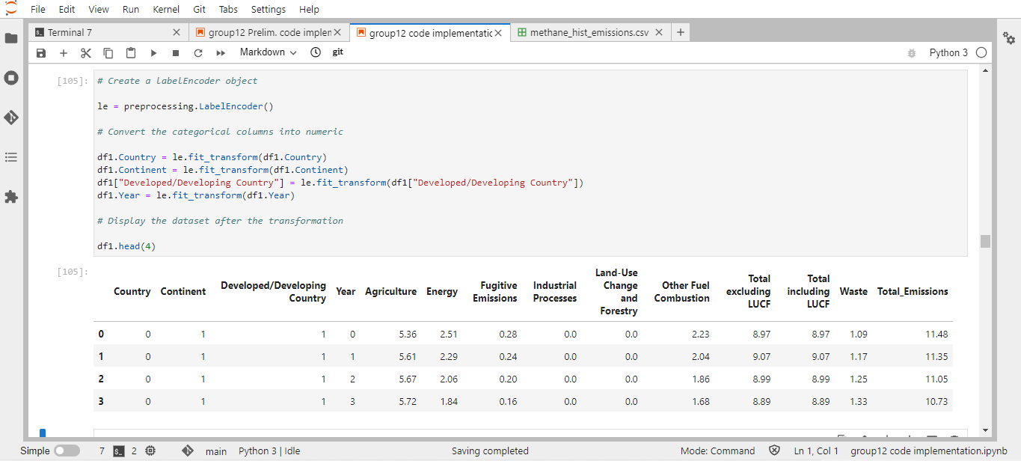
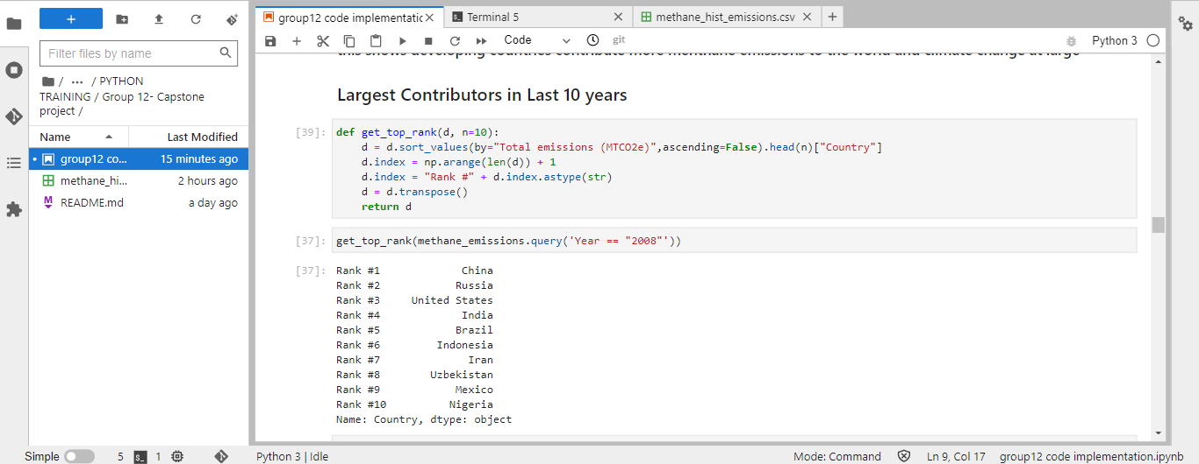
CODE IMPLEMENTATION CONTD
Fig. 5a
Fig. 5b

Slide 11
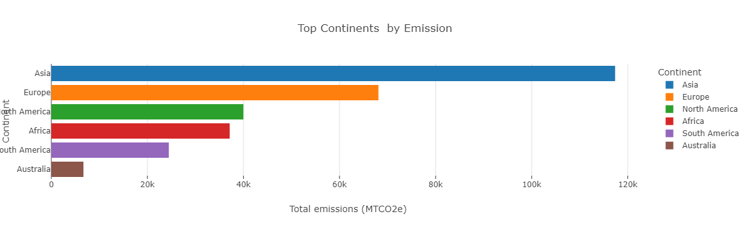
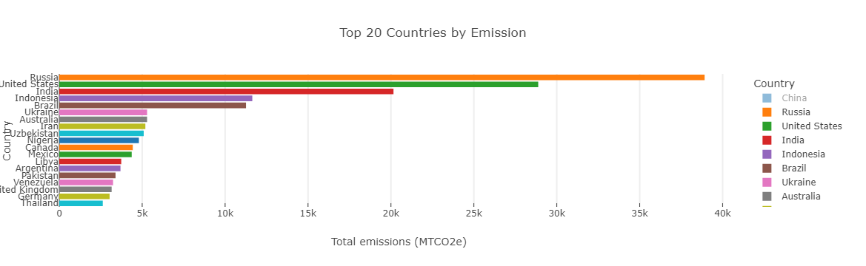
DATA VISUALIZATION
Fig. 6a
Fig. 6b

Slide 12
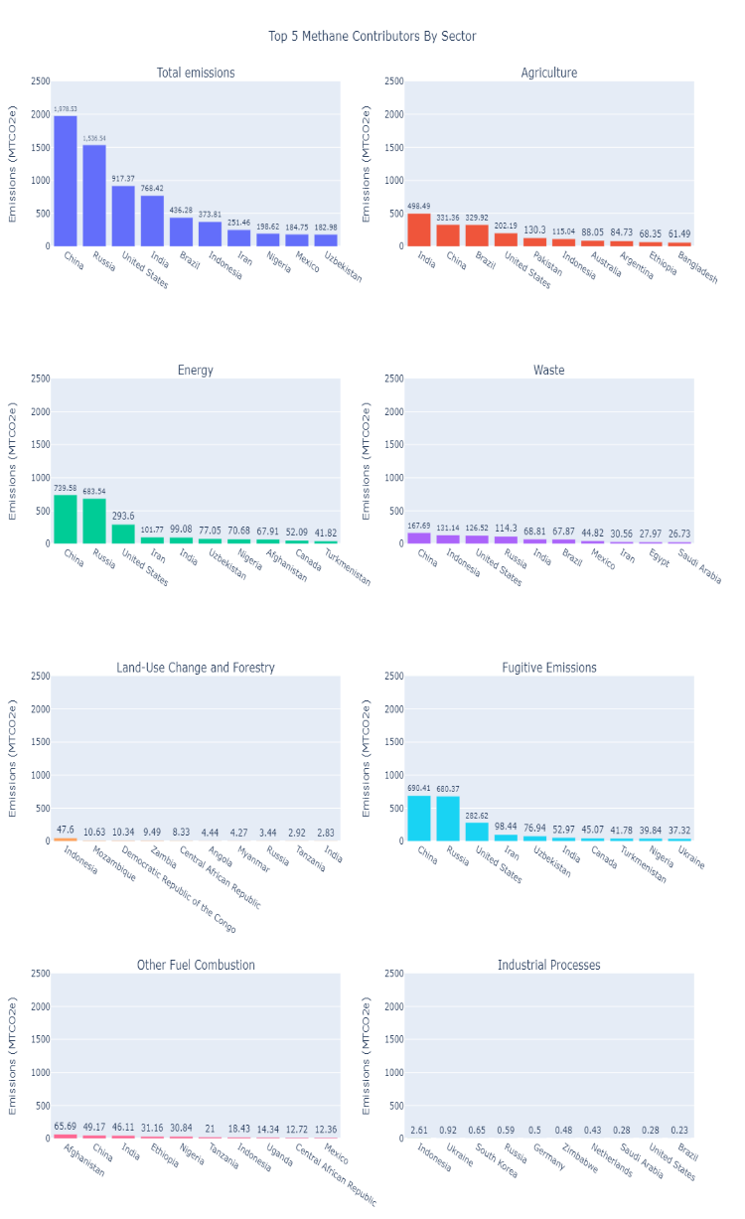
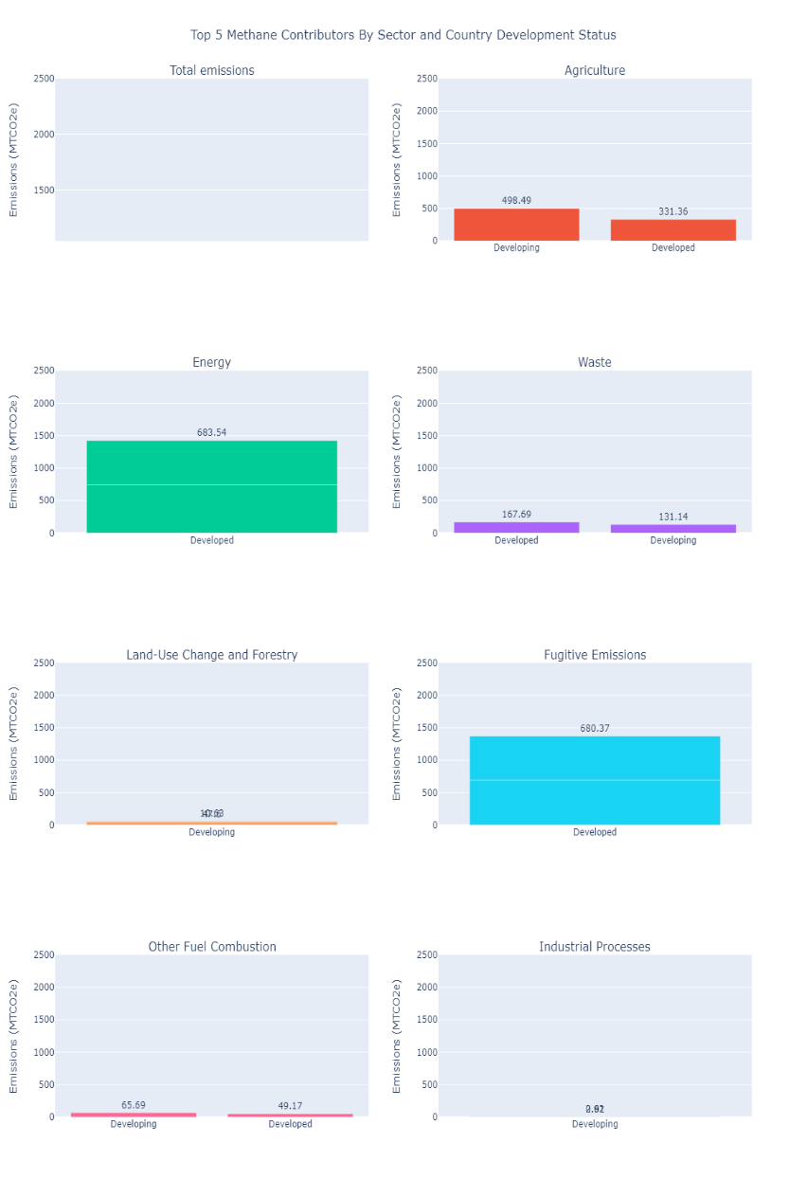
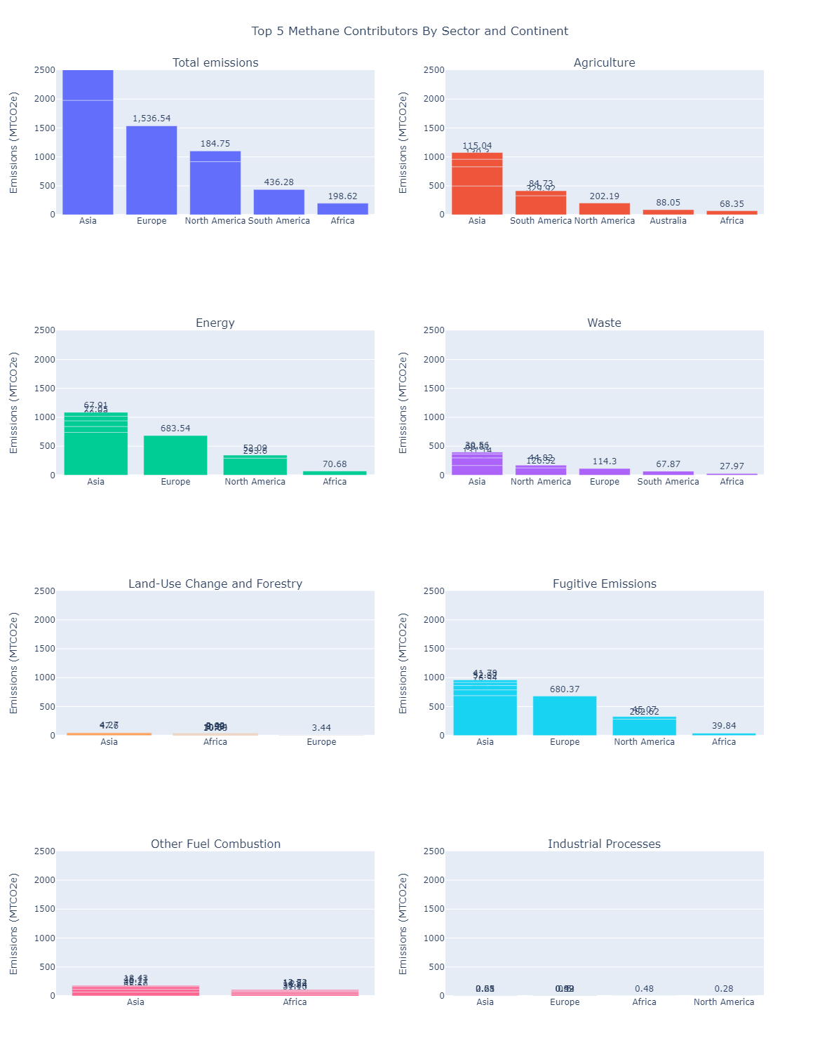
DATA VISUALIZATION CONTD
Fig. 7c
Fig. 7a
Fig. 7b

Slide 13
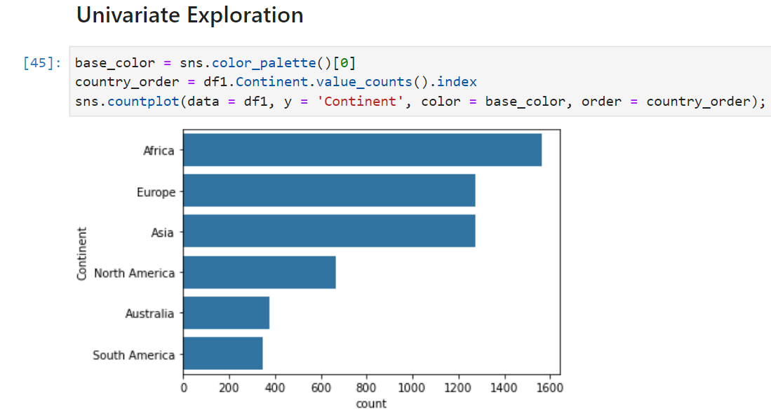
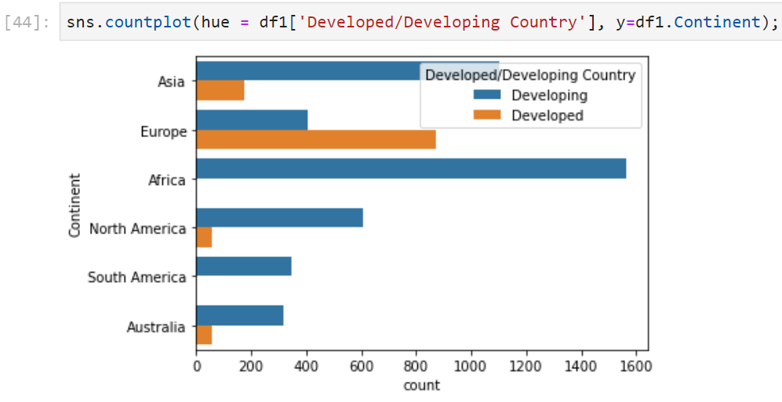
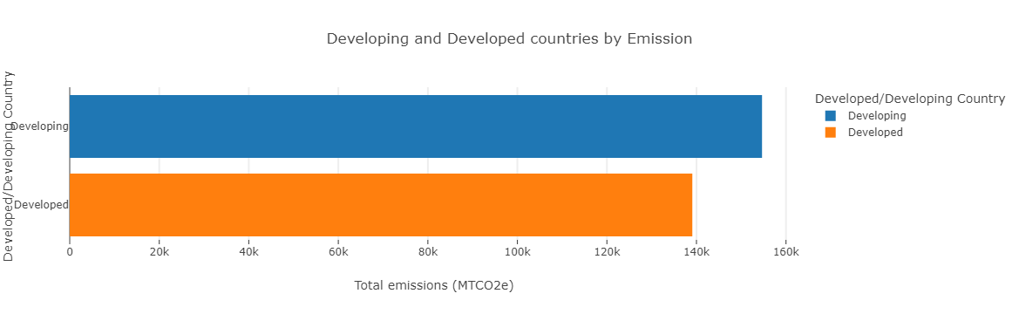
DATA VISUALIZATION CONTD
Fig. 8a
Fig. 8b
Fig. 8c

Slide 14
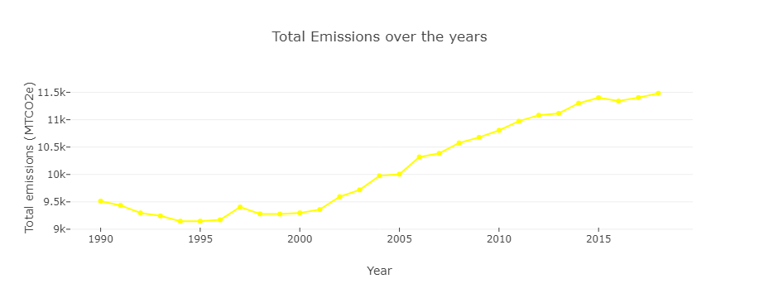
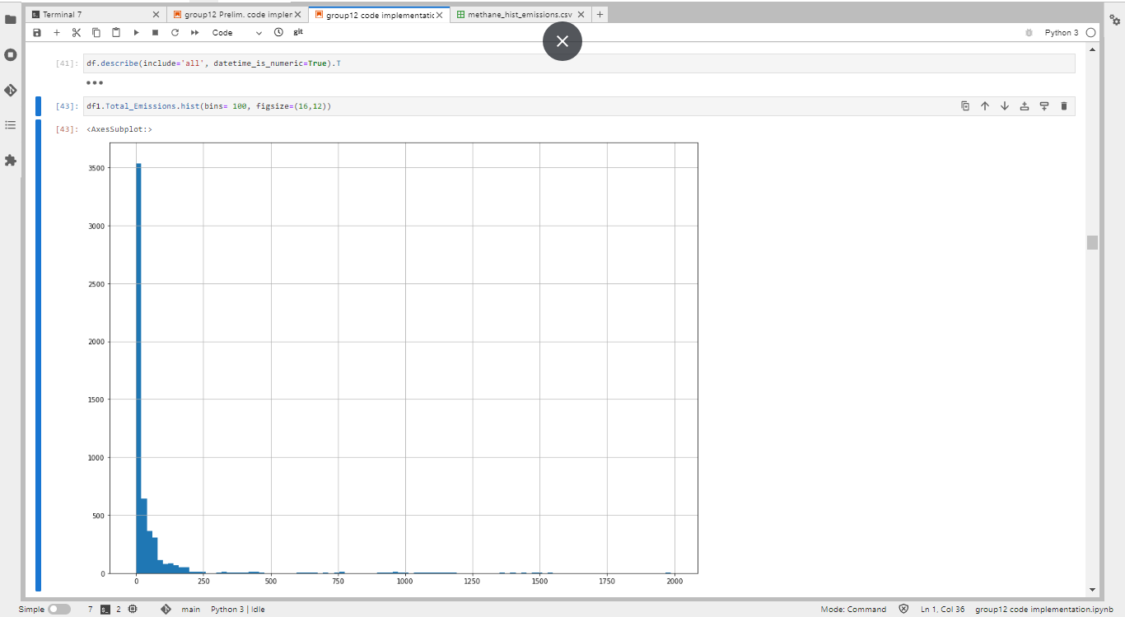
DATA VISUALIZATION CONTD
Title text addition
Fig. 9a
Fig. 9b
print the presentation and make it into a film to be used in a wider field

Slide 15
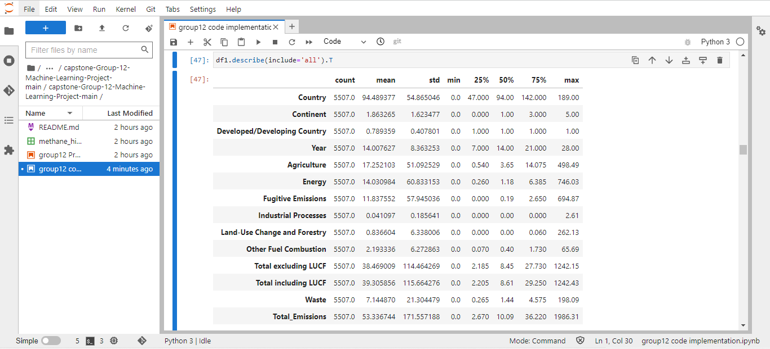
MODELLING
Fig. 10

Slide 16
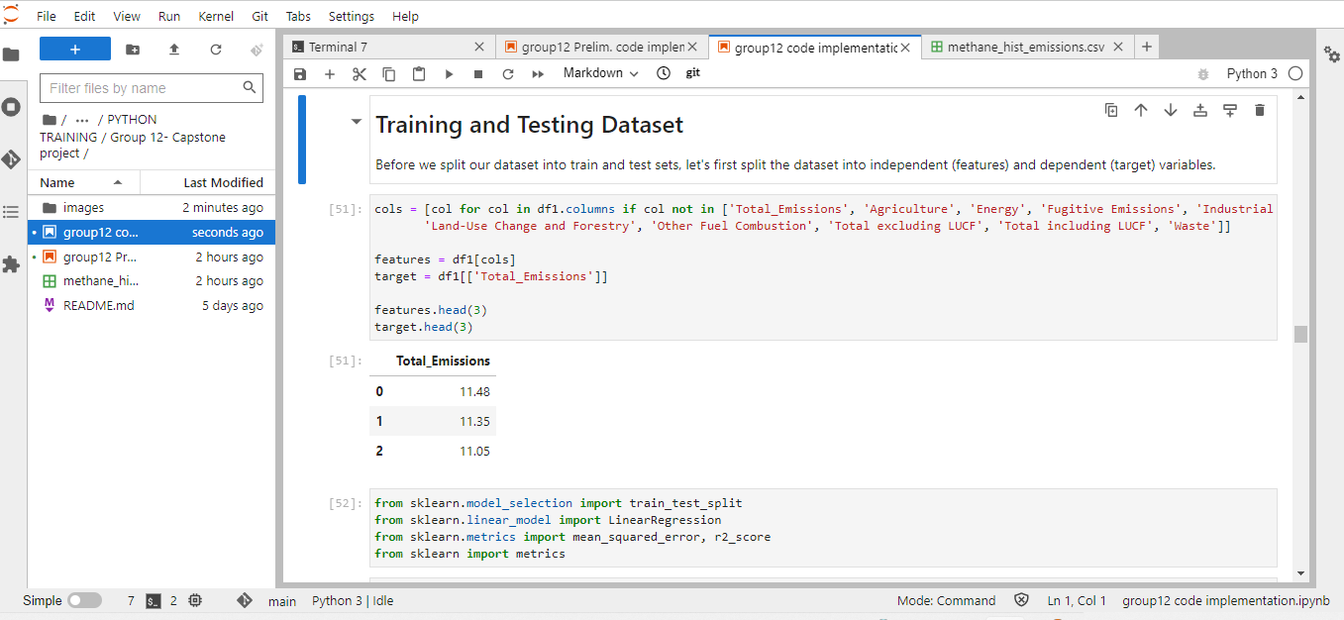
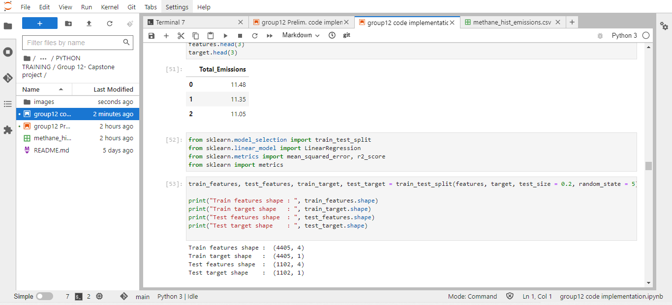
MODELLING SELECTION
Before we split our dataset into train and test sets, let's first split the dataset into independent (features) and dependent (target) variables.
Fig. 11a
Fig. 11b

Slide 17
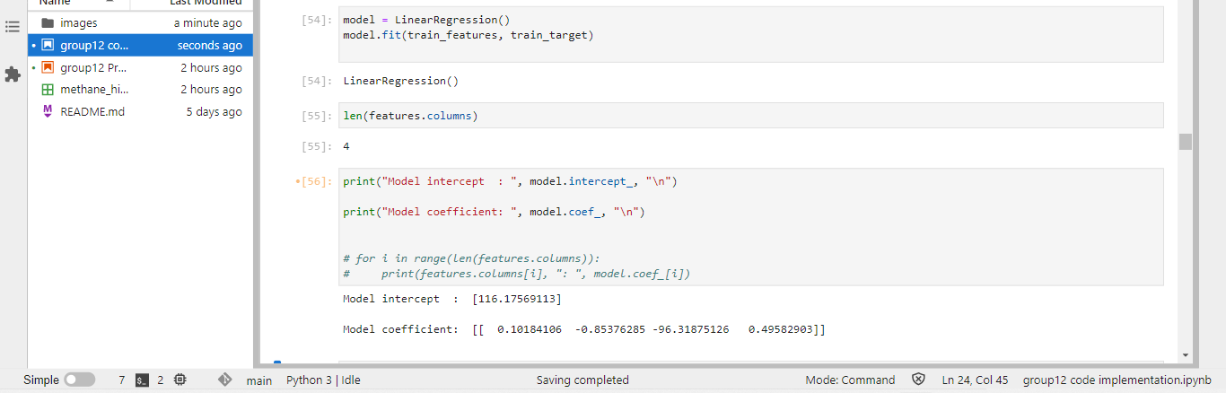
MODEL BUILDING
Our dataset made use of a single label variable (Total_Emissions) and multiple features (Continent, Country, Continent, Country, Developed/Developing Country and Year). Therefore we shall be making use of a Multiple Regression algorithm.
Title text addition
Keyword
Fig. 12a

Slide 18
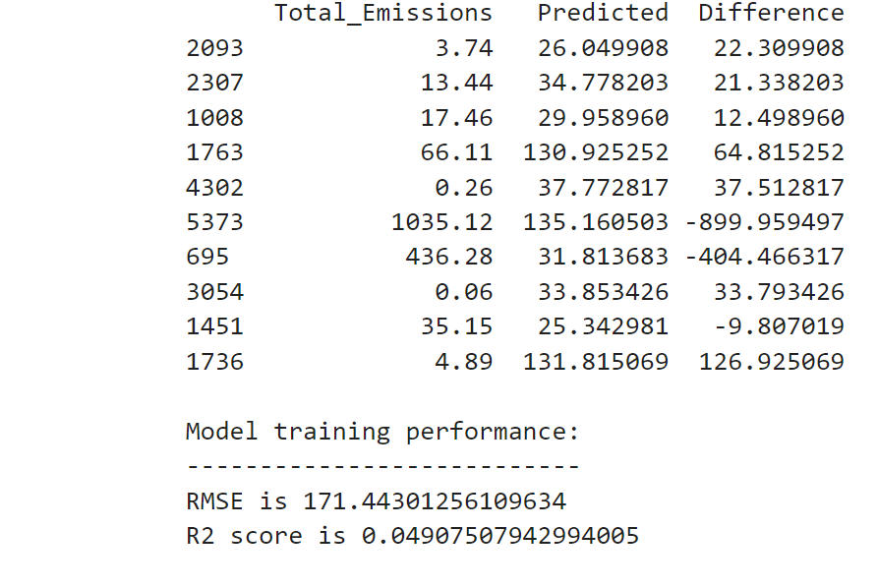
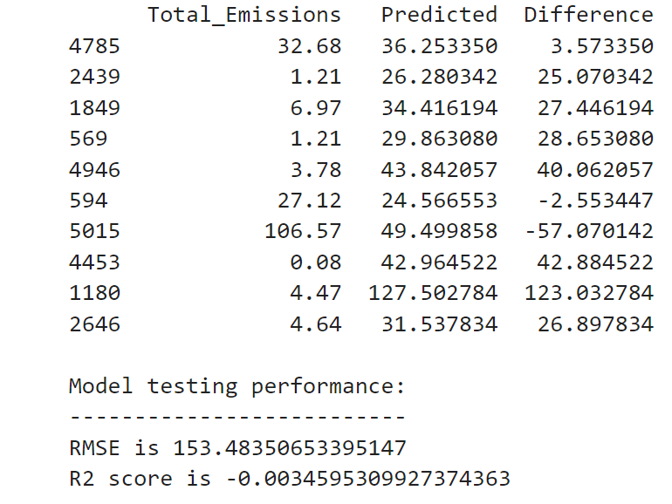
MODEL TESTING PERFORMANCE
Fig. 13a
Fig. 13b

Slide 19
ANALYSIS AND EVALUATION
The RMSE represents the sample standard deviation of the differences between predicted values and observed values (called residuals). The lower the RMSE, the better the given model is able to "fit" the dataset. The RMSE is particularly useful for comparing the fit of different regression models.
The R squared (also called the coeeficient of determination) of the model tells us the proportion of the variance in the response variable that can be explained by the predictor variable(s) in the model.

Slide 20
RESULT INTERPRETATION
It can be seen that the RMSE is quite high, indicating that our model isn't well optimised. This could be due to one or more of the following reasons:
The dataset needs further cleaning/preprocessing.
The dataset is too dispersed.
Some of the input variables do not have a linear relationship with the target variable.
We can attempt to resolve some of these issues by:
Carrying out further preprocessing and data cleaning such as outliers, invalid data, etc.
Carrying out normalization of some of the features.
Modify the train- test split ratios.
Try out other models.

Slide 21
POSSIBLE EFFECTS ON HUMAN HEALTH AND CLIMATE CHANGE
Methane emission is a major contributor to climate change with the emitting mediums generated by anthropogenic activities. From this study, if the rate of emission is not mitigated, it may have the following effects on , and the climatic condition of the Earth's atmosphere.
High level of methane causes reduction of oxygen in the earth atmosphere. Continuous methane emission build up troposphere ozone layer in the atmosphere which has been attributed to people suffering from of long-term effects including: Cardiovascular, respiratory and neurological problems. Development of epilepsy, pneumonia, claustrophobia and heart problems and many more.
Continuous release of methane emission into the atmosphere increases the rate of global warming leading to the losses of ice sheets, heat waves and sea level rising.

Slide 22
GITHUB GROUP 12 LINK
https://github.com/asgatcreation/capstone-Group-12-Machine-Learning-Project

Slide 23
THANK YOU FOR FOLLOWING
AND
LISTENING

